Slide 1
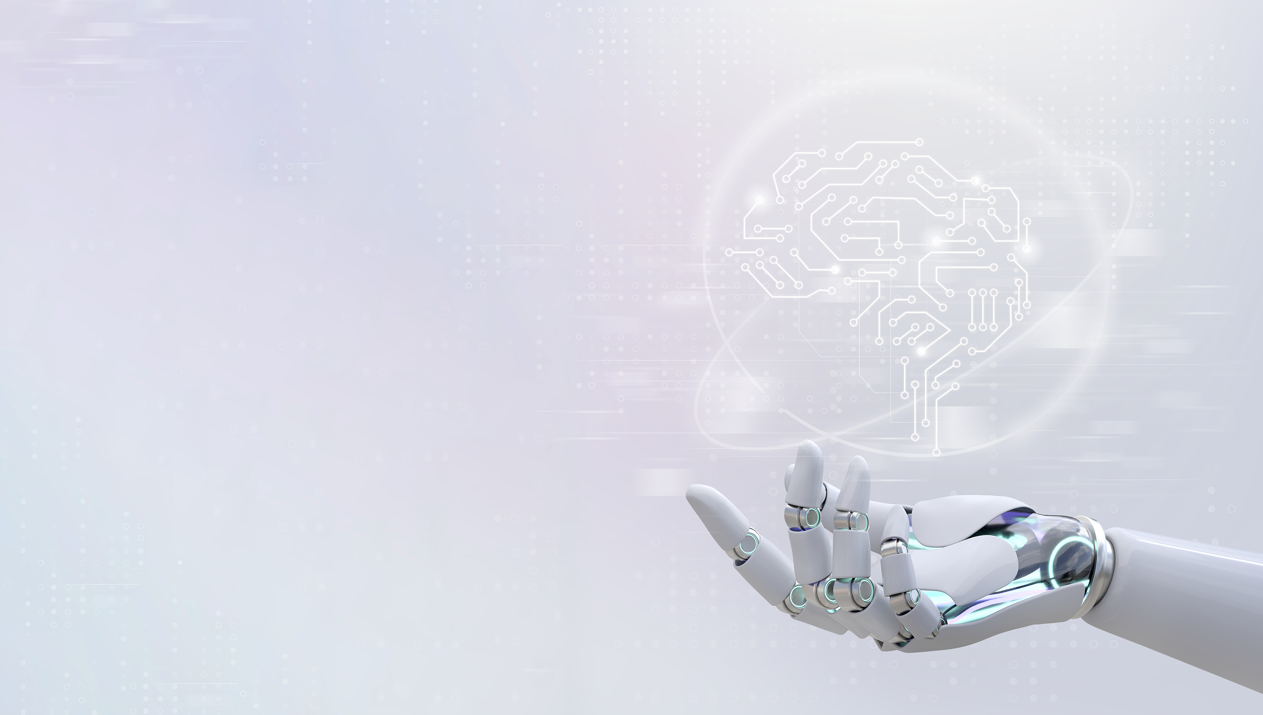


Hardware and Software Fundamentals of
Intelligent Computing
Systems
Notes:
需要涉及的要点：
- 第一课时：Compute Architectures 的逐渐演化：由AI/ML workload 引导，逐渐展示出多种多样的架构，如华为达芬奇、AMD等等
- 第二课时：互联的硬件基础，与CUDA core、Tensor core 的编程。
- 可能还需要涉及的点：课程整体设计（Syllabus、各个模块的内容，根据教学大纲生成了个overview的图）

Slide 2
Course Overview
Week | Module | Main Content
1 | Module 1: AI System Fundamentals & Heterogeneous Computing | Overview of AI hardware architecture; challenges to Moore's Law and trends in heterogeneous computing
2 |  | SIMT programming model; thread hierarchy and memory hierarchy
3 |  | Analysis of deep learning framework call chains; Shared Memory and Bank Conflict
4 |  | Cache locality optimization; Tiled matrix multiplication; Introduction to Triton
5 | Module 2: High-Performance AI Operators & Operator Engineering | Principles of Transformer attention mechanism; design and implementation of FlashAttention
6 |  | Optimization of convolution, normalization, and activation function operators
7 |  | Operator fusion techniques; debugging and profiling of complex operators
8 |  | Q&A and discussion on Module 1 / Module 2 labs
9 | Module 3: AI Compiler Principles & Optimization | Overview of AI compilers; fundamentals of Intermediate Representation (IR); SSA and computation graphs
10 |  | In-depth analysis of MLIR architecture
11 |  | Operator fusion passes: graph matching, pattern recognition, and subgraph rewriting
12 |  | Layout and memory planning; multi-chip backend code generation
13 | Module 4: Distributed Parallel Training & Communication | Principles of data parallelism, tensor parallelism, and pipeline parallelism
14 |  | Communication primitives and topology optimization; hybrid parallelism and memory optimization
15 | Module 5: Performance Evaluation & Frontier Outlook | Operator performance metrics; automatic operator tuning; LLM-assisted code generation
16 |  | Specialized optimization for domestic AI chips; FlagOS ecosystem and frontier technology outlook; course summary

Slide 3
Lecture 01: Course Introduction and AI Hardware Landscape

Slide 4


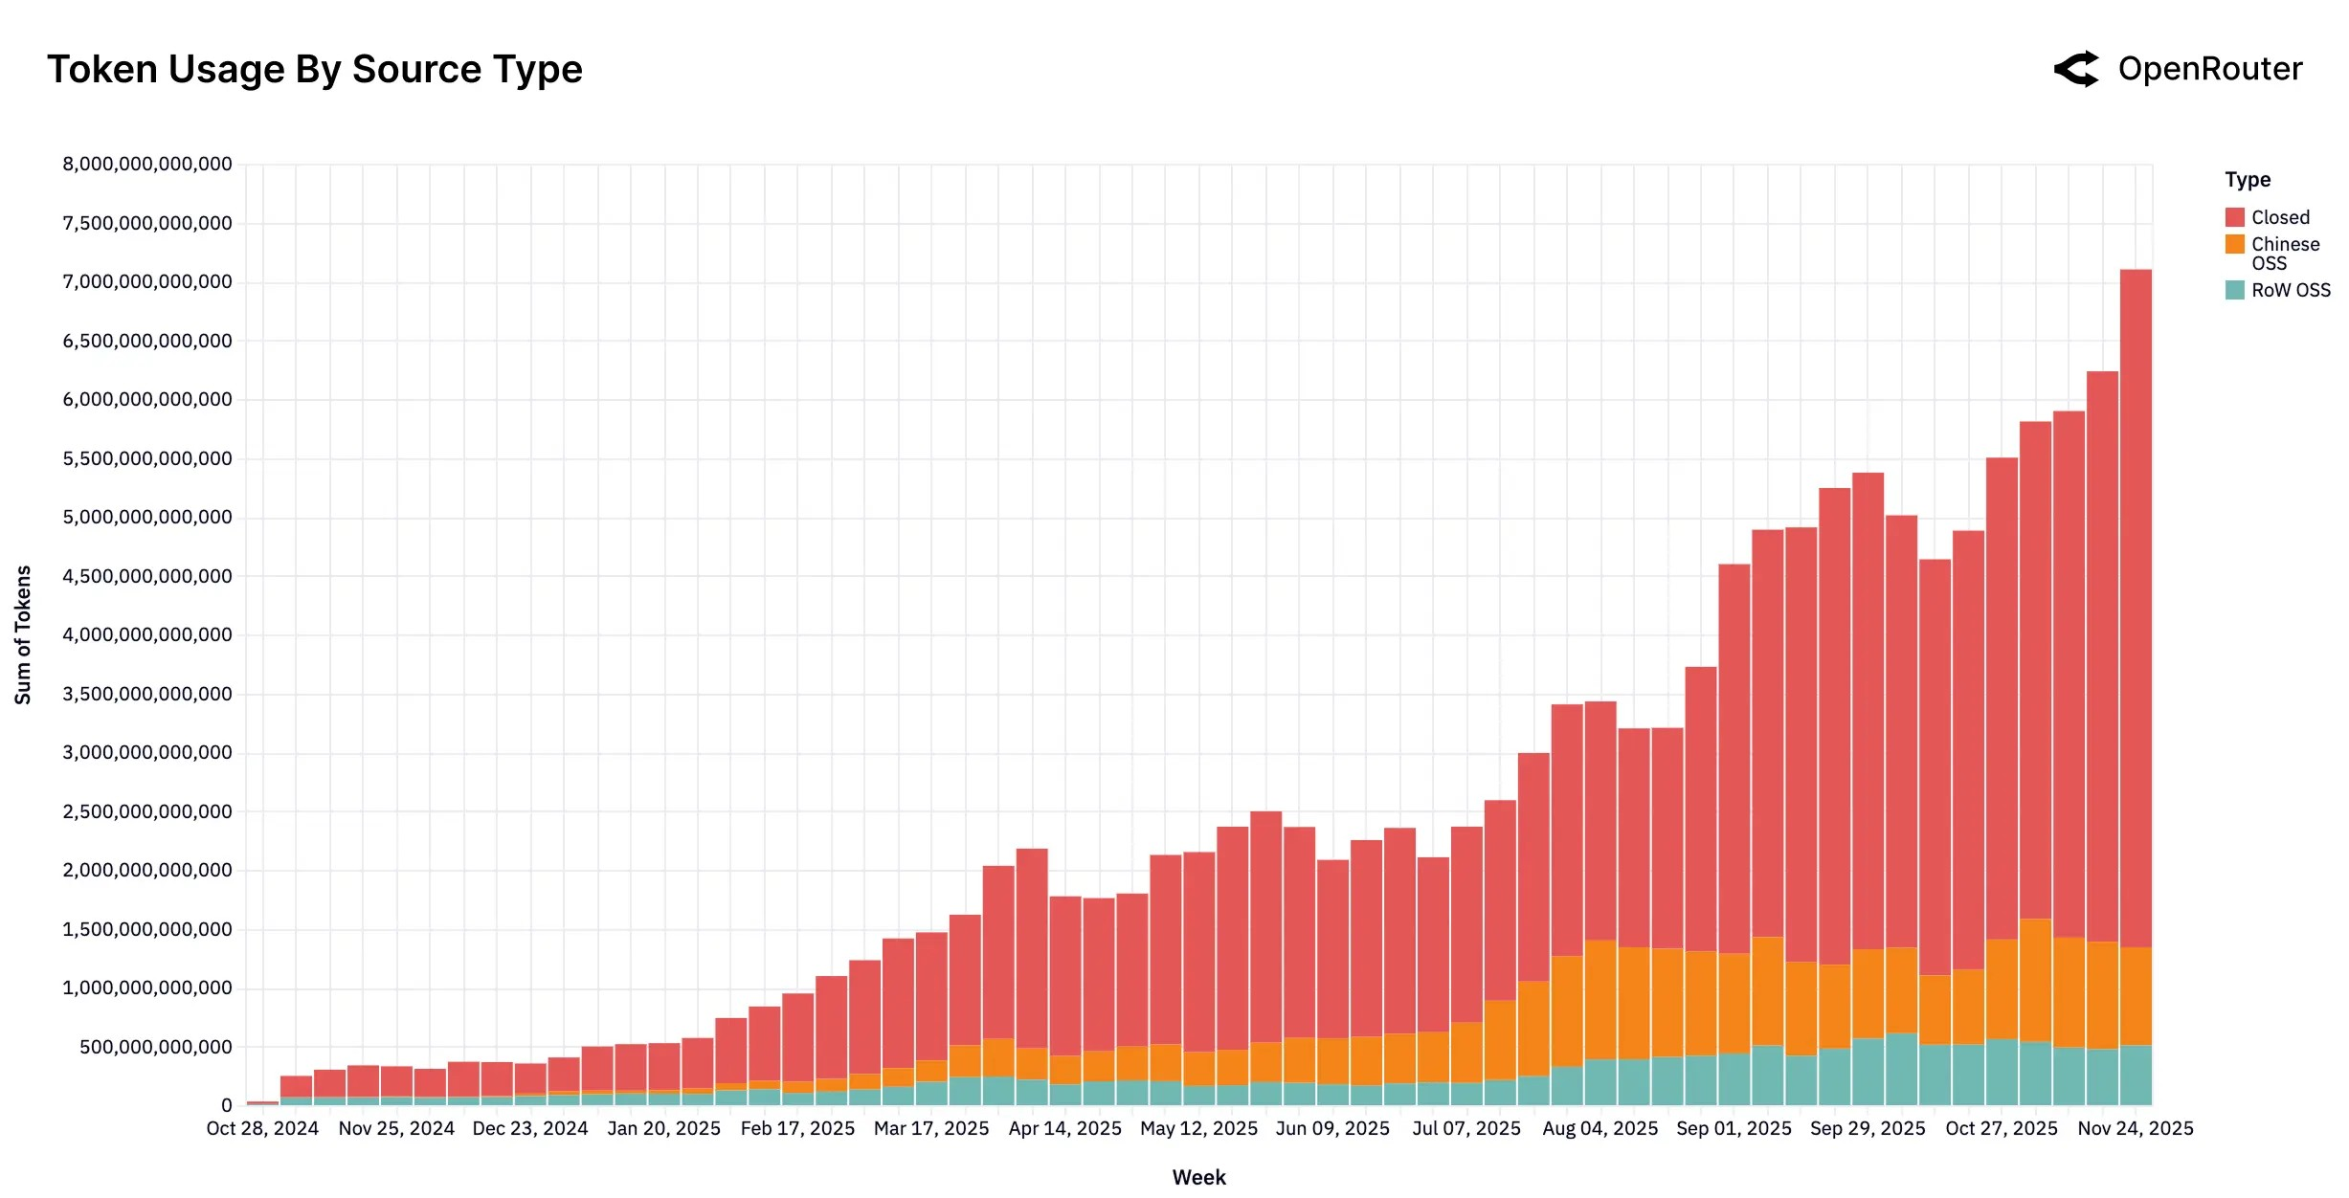

Token-Hungry Generative AI Applications
LLM-powered autonomous agents
Token consumption trends
AI mobile phone and AI PC
Video generation
image source: lilianweng.github.io, openrouter.ai, 36kr.com (with doubao phone), github.com/baaivision/URSA
Notes:
https://lilianweng.github.io/posts/2023-06-23-agent/
https://openrouter.ai/announcements/the-2025-state-of-ai-report
https://github.com/baaivision/URSA
https://eu.36kr.com/en/p/3576900266261385

Slide 5
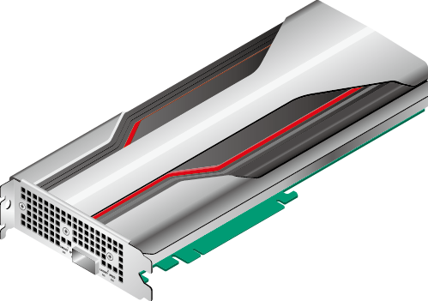
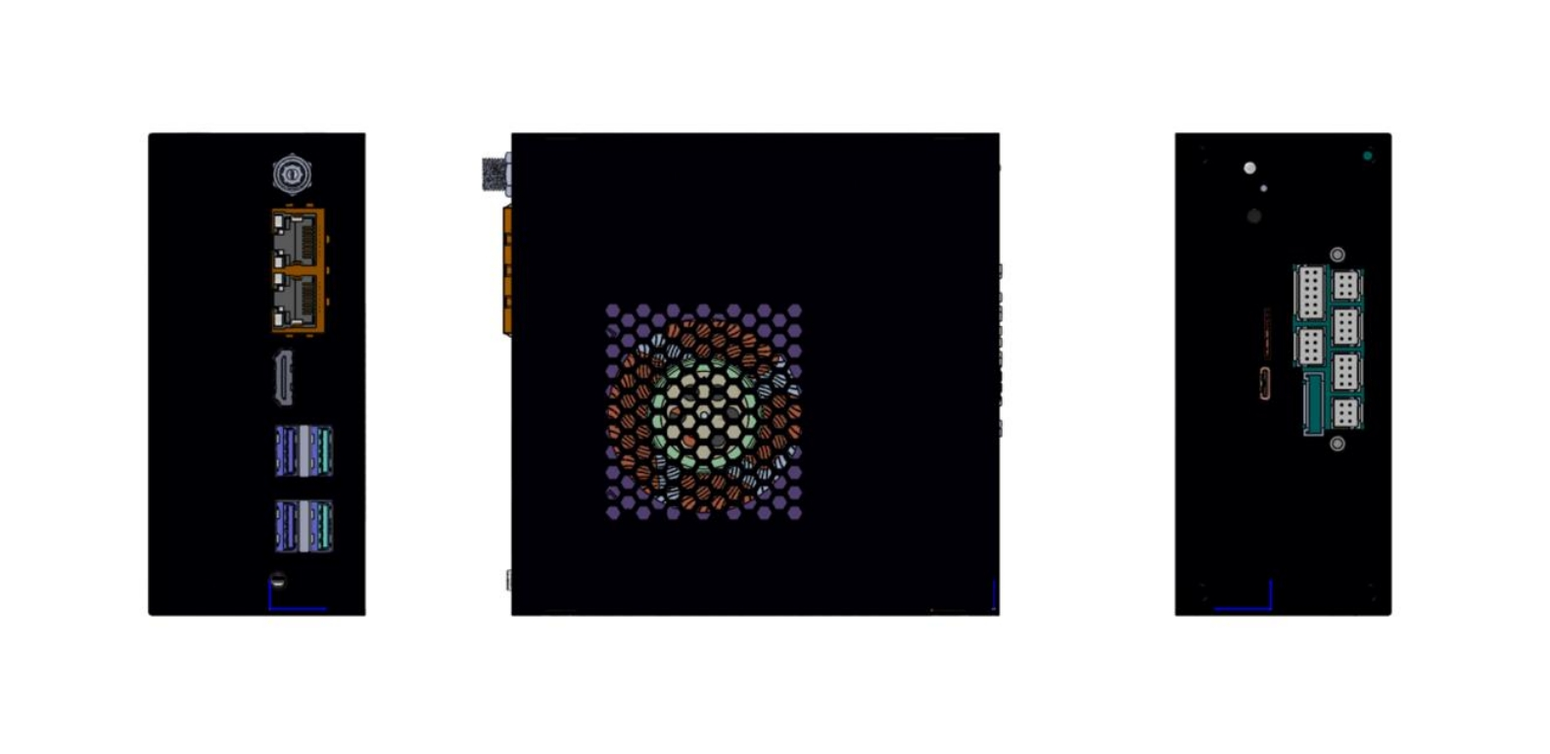
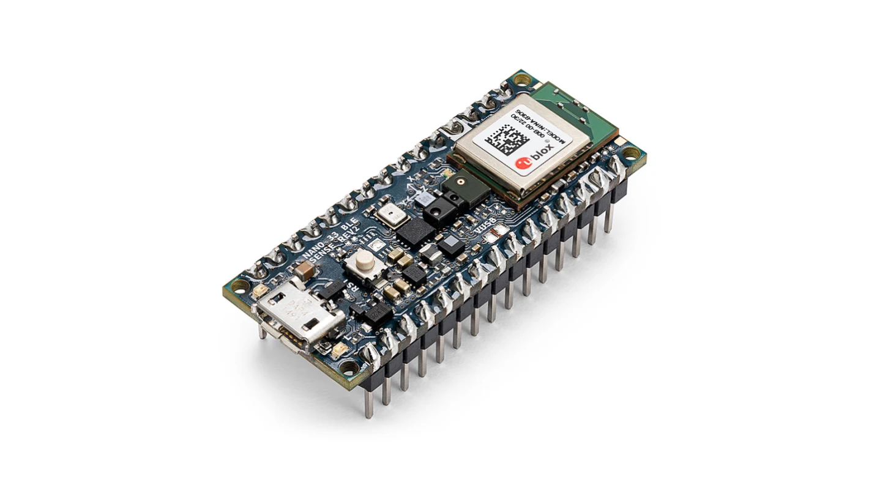

AI Hardware Spectrum: Key Examples
Cloud ML
Huawei Ascend
Cambricon MLU370
etc.
Edge ML
Iluvatar
TY1200
Mobile ML
Kirin 9030 Pro
Tiny ML
Arduino Nano 33
BLE Sense
Notes:
https://support.huawei.com/enterprise/zh/doc/EDOC1100162135/74b99d28
https://consumer.huawei.com/cn/phones/mate-x7/

Slide 6
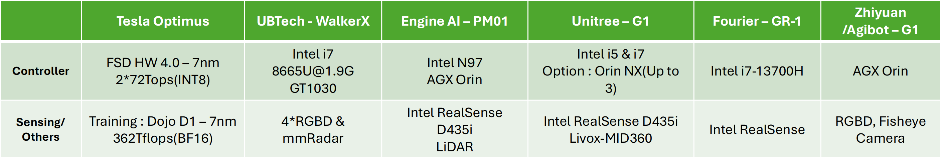
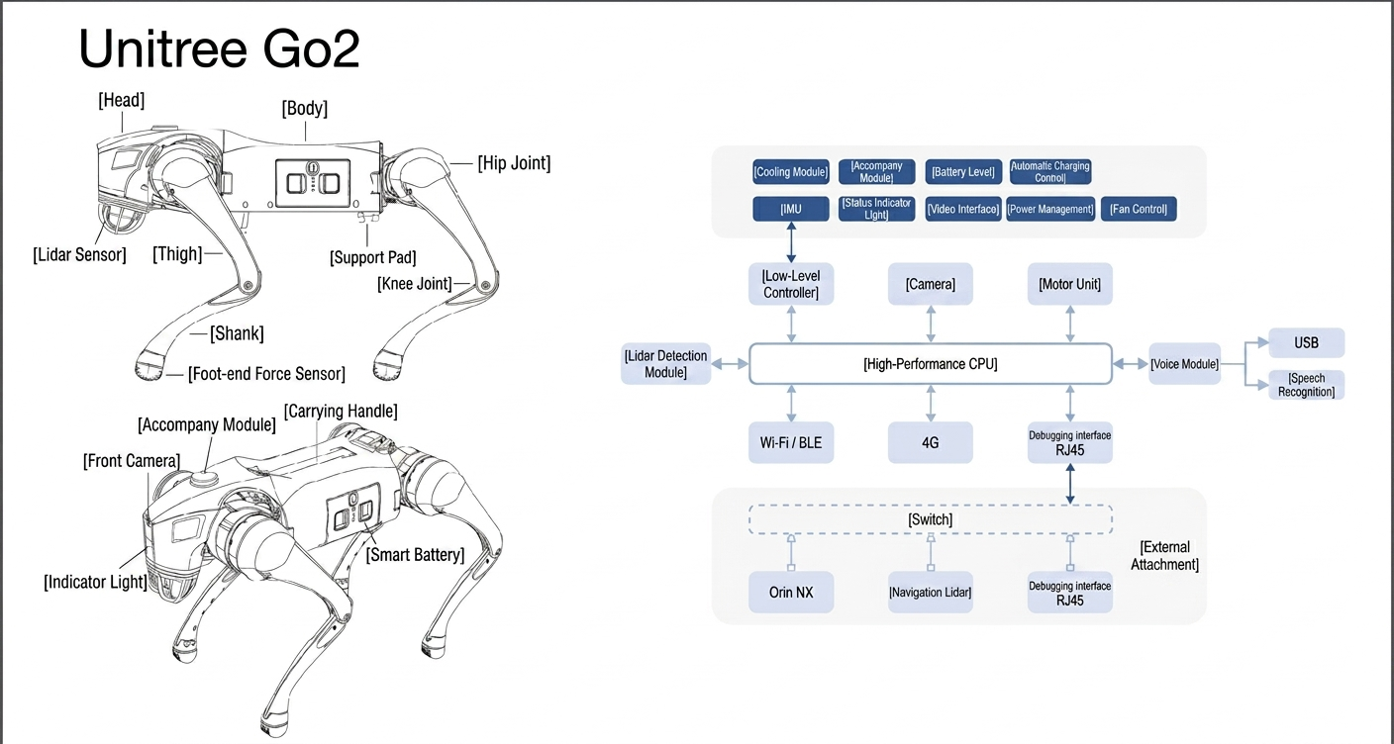

Slide 7
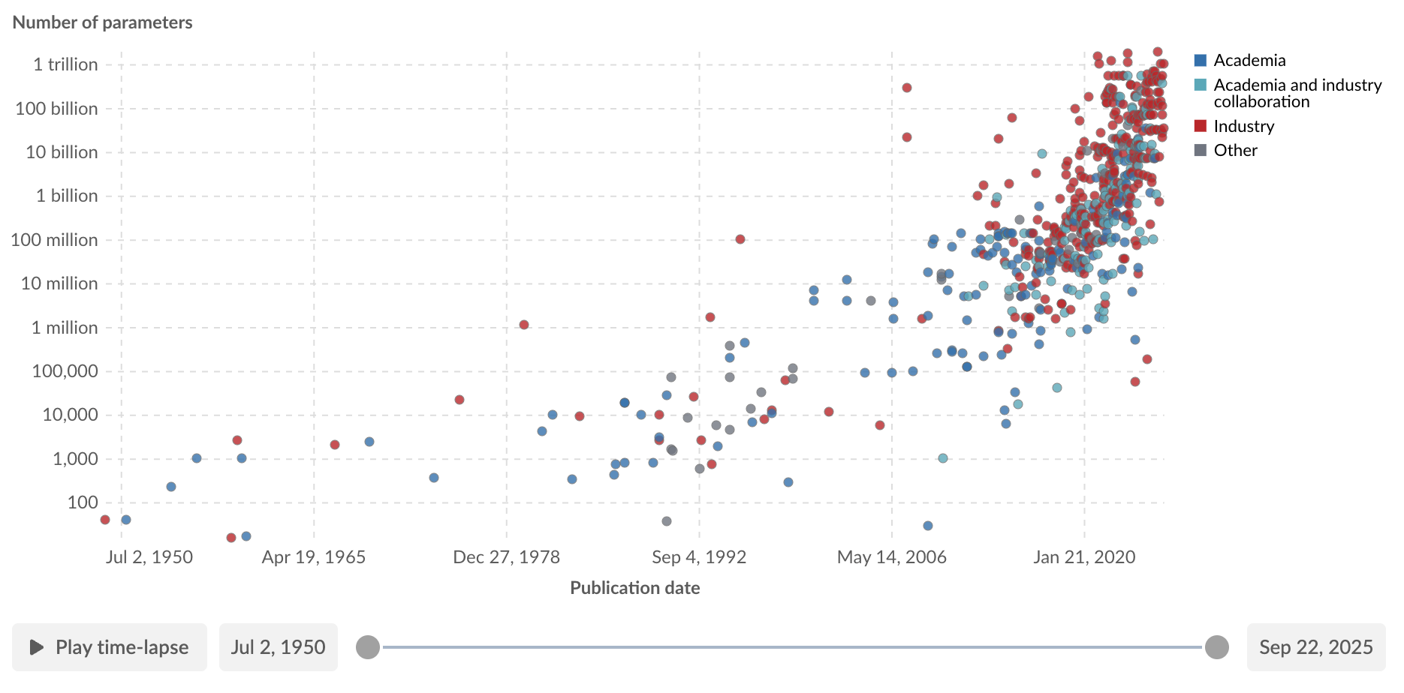
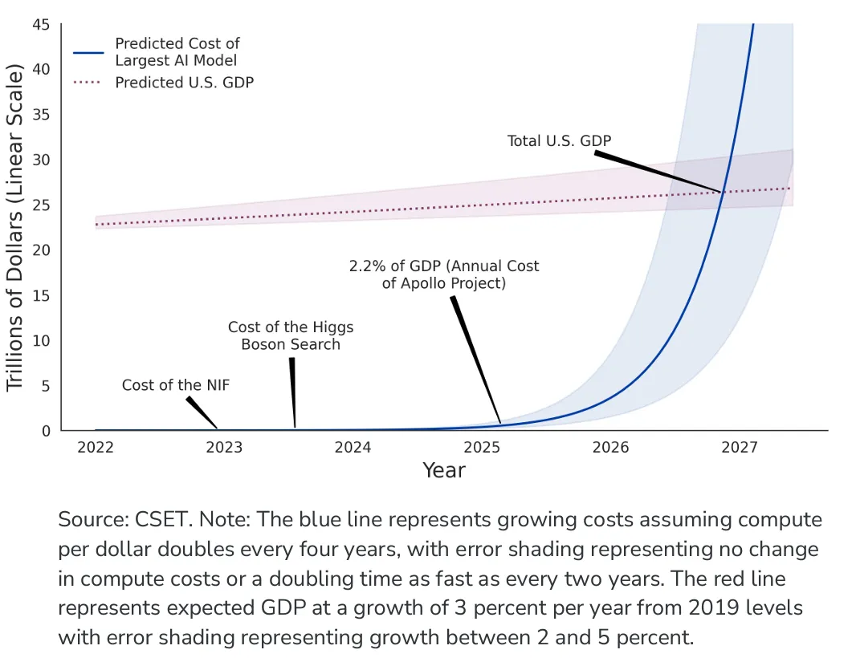
The Hardware Demands of AI/ML
Model Parameters
  The exponential growth.
Computational Demand
  Outpacing the Moore's Law.
  Comparison between compute cost and U.S GDP byOpenAI.
Communication Scale
  The new critical bottleneck.
image: https://medium.com/geekculture/business-analysis-ai-computational-cost-67a136957c95
https://ourworldindata.org/grapher/artificial-intelligence-parameter-count

Slide 8
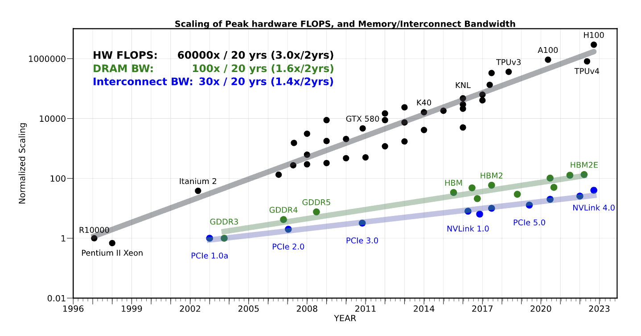
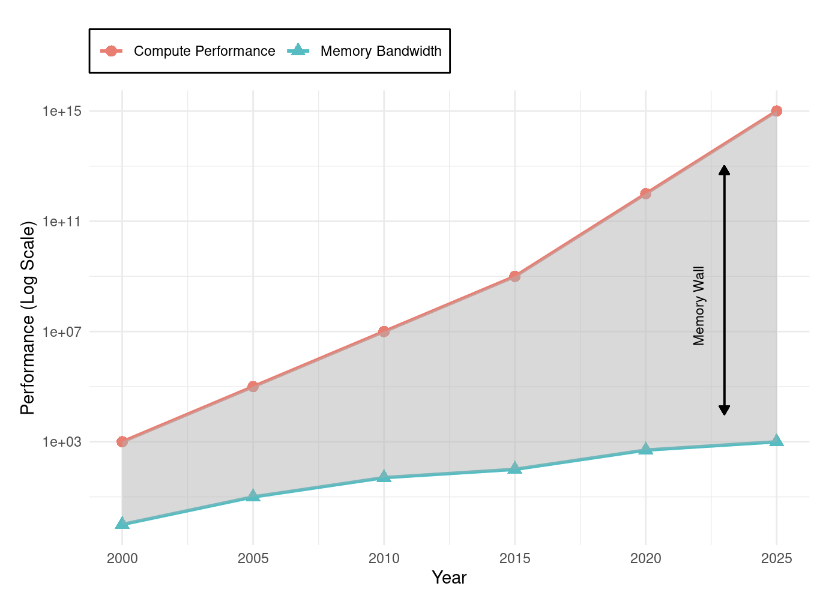
Why General-Purpose CPUs Failed AI (1/2)
The CPU's Legacy:
  For decades, the Central Processing Unit (CPU) was the universal engine of computing, designed for sequential, general-purpose tasks.
The Two Crises:
  Von Neumann Bottleneck: Constant data shuffling between processing and memory units created a fundamental efficiency limit, consuming more energy than the actual computation.
  End of Performance Scaling: Dennard Scaling and the derived performance effects from Moore’s Law, which provided decades of exponential performance growth, came to an end.
A. Gholami, Z. Yao, S. Kim, C. Hooper, M. W. Mahoney and K. Keutzer, "AI and Memory Wall," in IEEE Micro, vol. 44, no. 3, pp. 33-39, May-June 2024, doi: 10.1109/MM.2024.3373763.
Notes:
找权威的数据或者来源

Slide 9
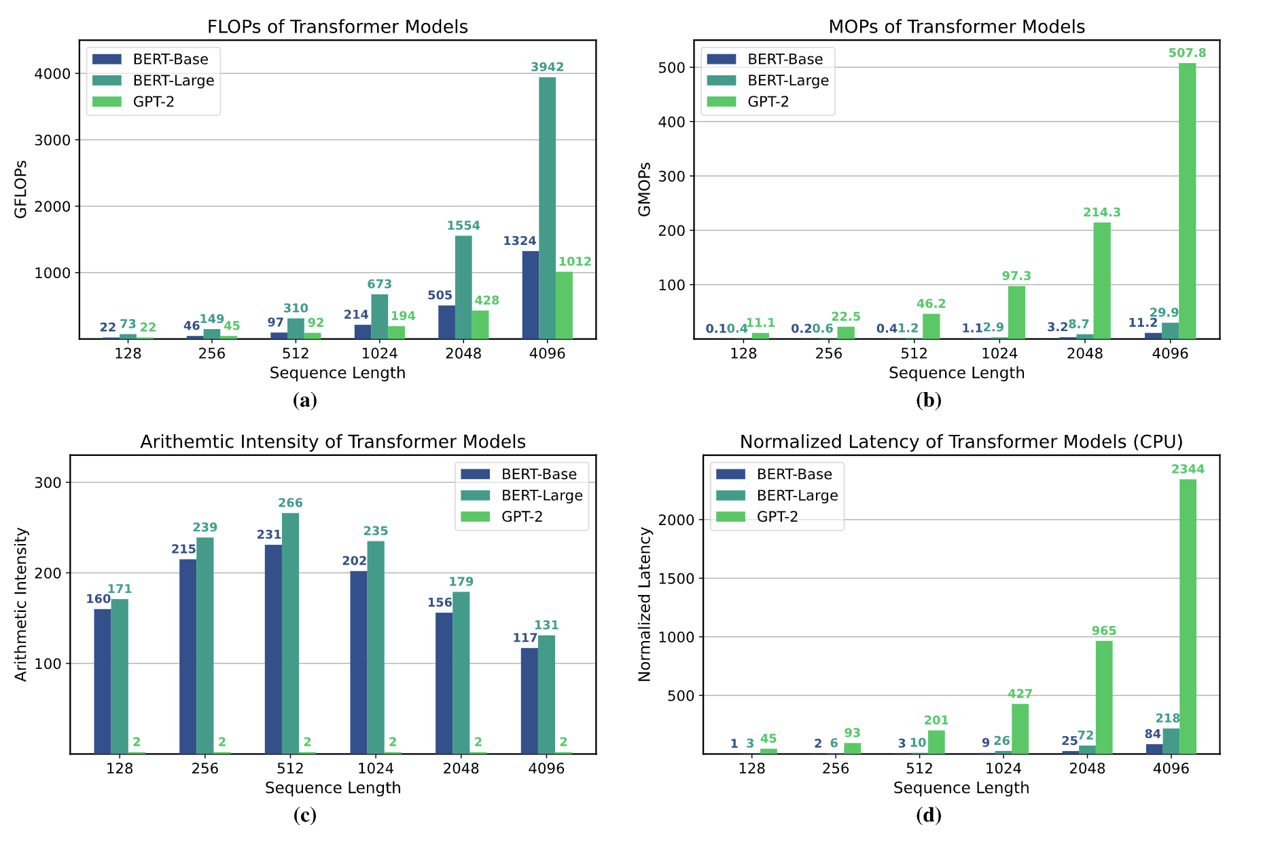
Why General-Purpose CPUs Failed AI (2/2)
The Mismatch:
  CPUs' sequential design is fundamentally inefficient for the massive parallelism inherent in AI workloads like matrix multiplication.
  CPUs achieve only 5-10% utilization on neural network workloads, delivering approximately 100 GFLOPS10 while consuming hundreds of watts*.
Conclusion:
  AI's exponential demands exposed the limits of the general-purpose model, forcing a shift to specialized hardware.
A. Gholami et al., "AI and Memory Wall," in IEEE Micro, vol. 44, no. 3, pp. 33-39, May-June 2024.
Notes:
找权威的数据或者来源

Slide 10
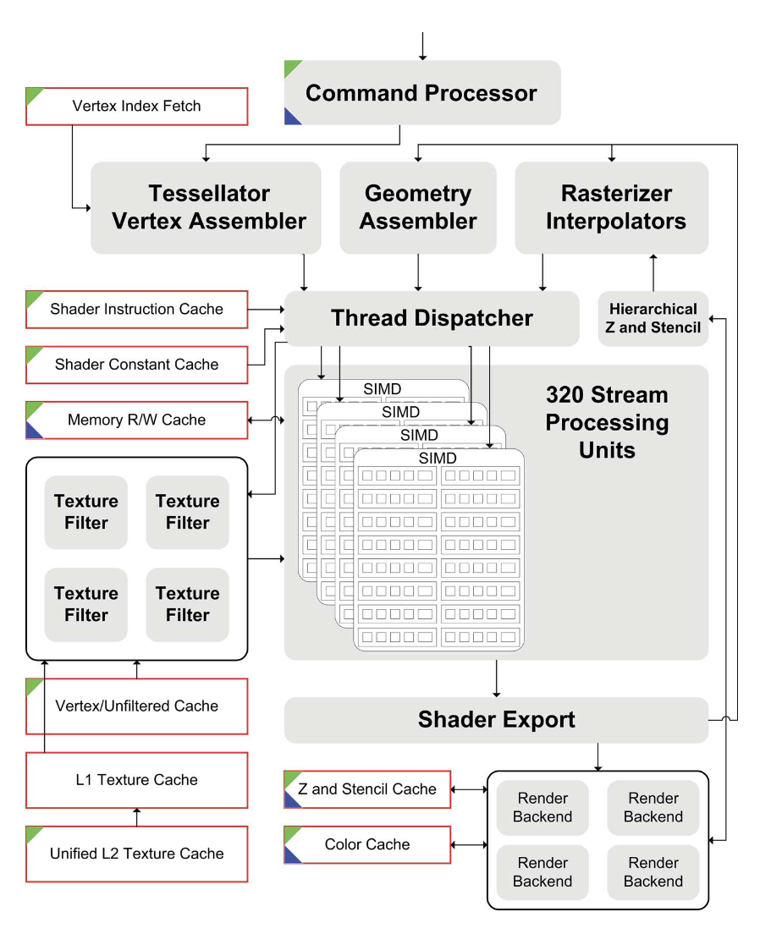
The Rise of the GPU
An Unlikely Hero: The Graphics Processing Unit (GPU) was born in the late 1990s for video game graphics, featuring thousands of simple cores for parallel tasks.
Architectural Resonance: The core math of graphics (matrix and vector operations) was identical to the math of deep learning, making GPUs a perfect, albeit accidental, fit.
J. D. Owens, M. Houston, D. Luebke, S. Green, J. E. Stone and J. C. Phillips, "GPU Computing," in Proceedings of the IEEE, vol. 96, no. 5, pp. 879-899, May 2008, doi: 10.1109/JPROC.2008.917757.

Slide 11
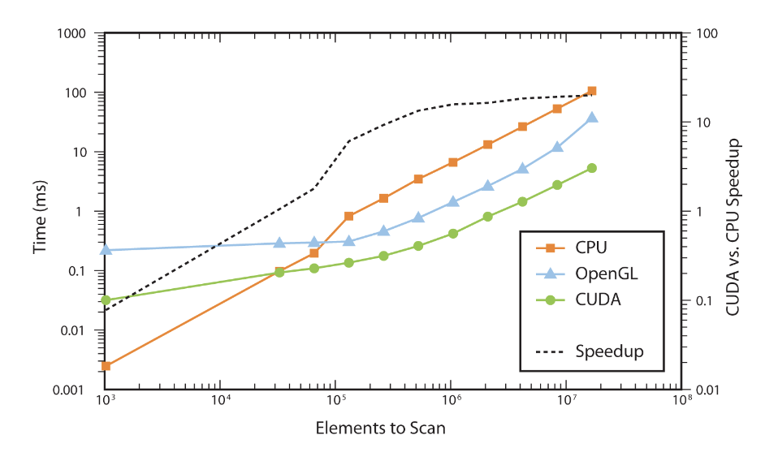
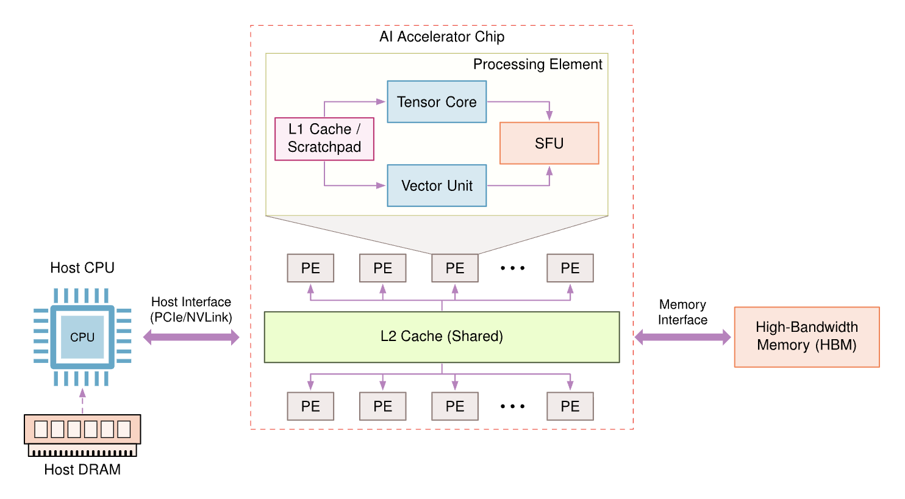
The Rise of the GPU
The Software Catalyst: CUDA: NVIDIA's CUDA platform (2007) unlocked the GPU for general-purpose computing, making its power accessible to AI researchers without deep graphics expertise.
The Result: Training times for AI models plummeted from weeks to hours, establishing the GPU as the de facto standard for AI training.
J. D. Owens, M. Houston, D. Luebke, S. Green, J. E. Stone and J. C. Phillips, "GPU Computing," in Proceedings of the IEEE, vol. 96, no. 5, pp. 879-899, May 2008, doi: 10.1109/JPROC.2008.917757.

Slide 12
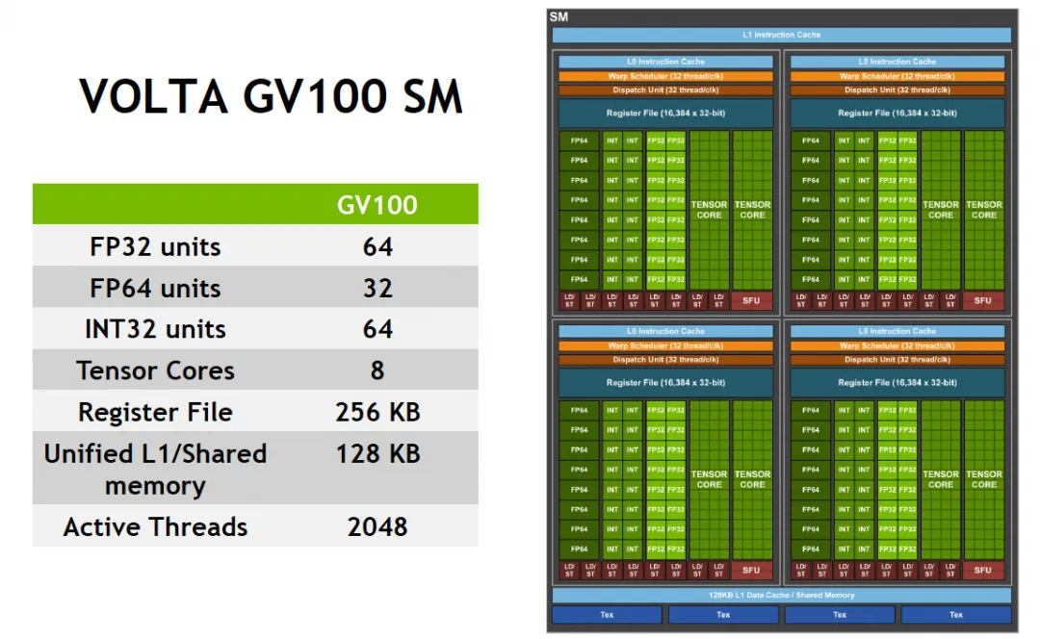
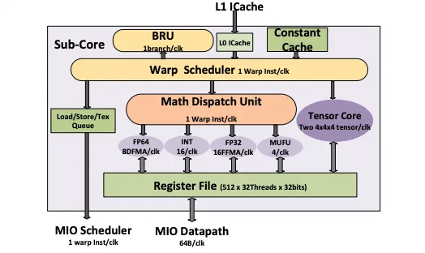
1st-Gen Tensor Core: Warp-scoped MMA

Slide 13
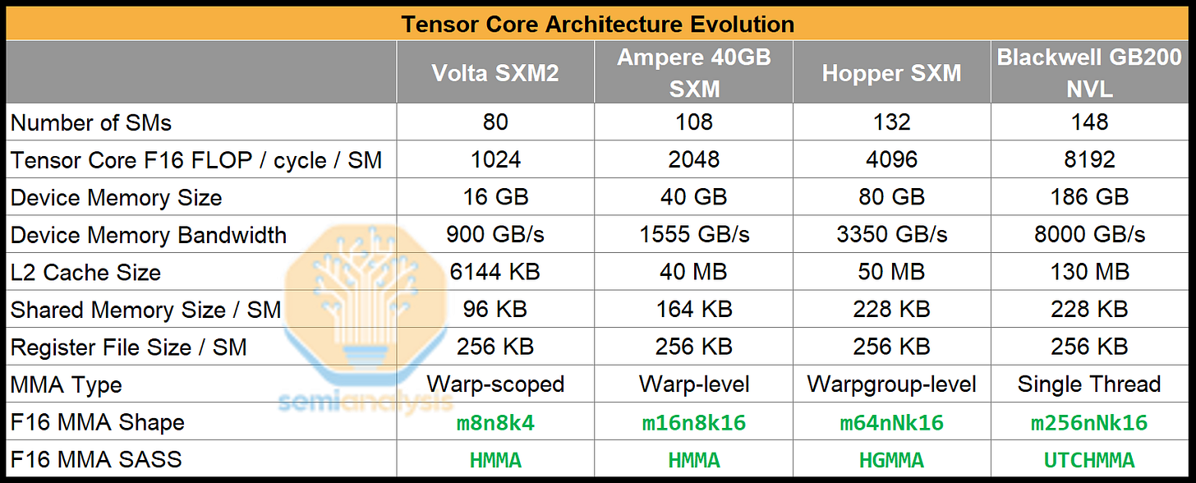
Scaling of Tensor Cores in NIVIDIA GPUs (1/3)

Slide 14
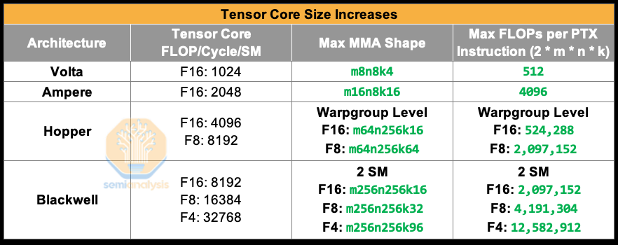
Scaling of Tensor Cores in NIVIDIA GPUs (2/3)

Slide 15
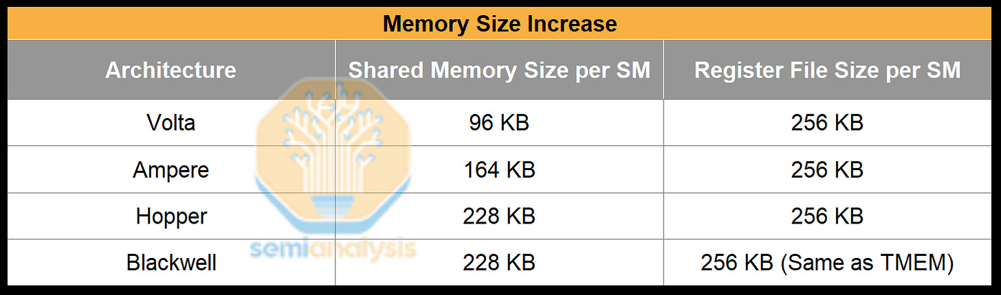
Scaling of Tensor Cores in NIVIDIA GPUs (3/3)
Tensor Core throughput doubled every generation, but global memory load latency didn’t decrease and in fact increased. As a result, we need to increase the staging SMEM size for buffering more data

Slide 16
Compute Architectures Evolve
GPU series (+ Tensor cores)
TPU series
Ascend series
CPU series: Intel (+ matrix extension); AMD (+ NPU)
compute-in-memory
wafer-scale chip
Supernode and Hypercomputer
...

Slide 17
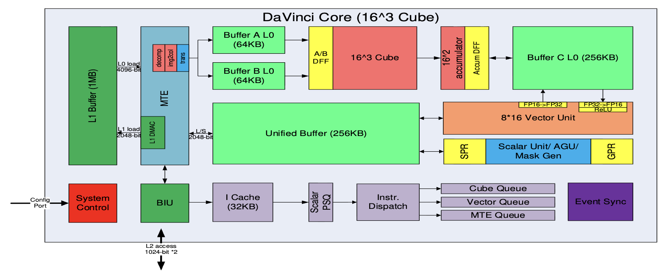
Huawei DaVinci Architecture
Cube：4096(16^3) FP16 MACs + 8192 INT8 MACs
Vector：2048bit INT8/FP16/FP32 vector with special functions（activation functions, NMS- Non Minimum Suppression, ROI, SORT）
Explicit memory hierarchy design, managed by MTE
H. Liao, J. Tu, J. Xia and X. Zhou, "DaVinci: A Scalable Architecture for Neural Network Computing," IEEE Hot Chips 31 Symposium (HCS), 2019.
Notes:
详细讲一些

Slide 18
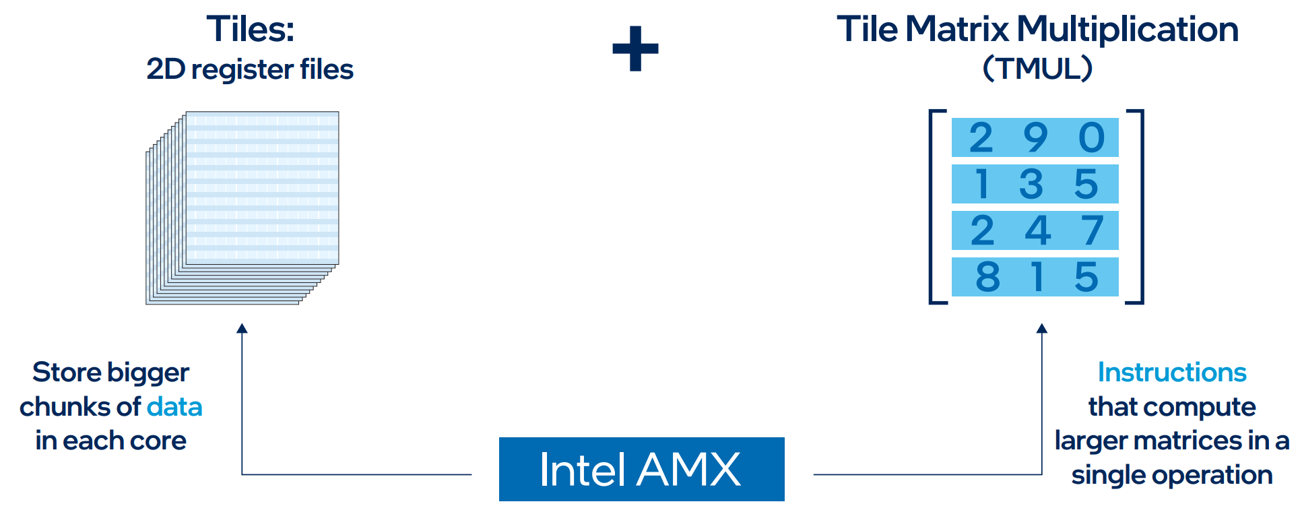
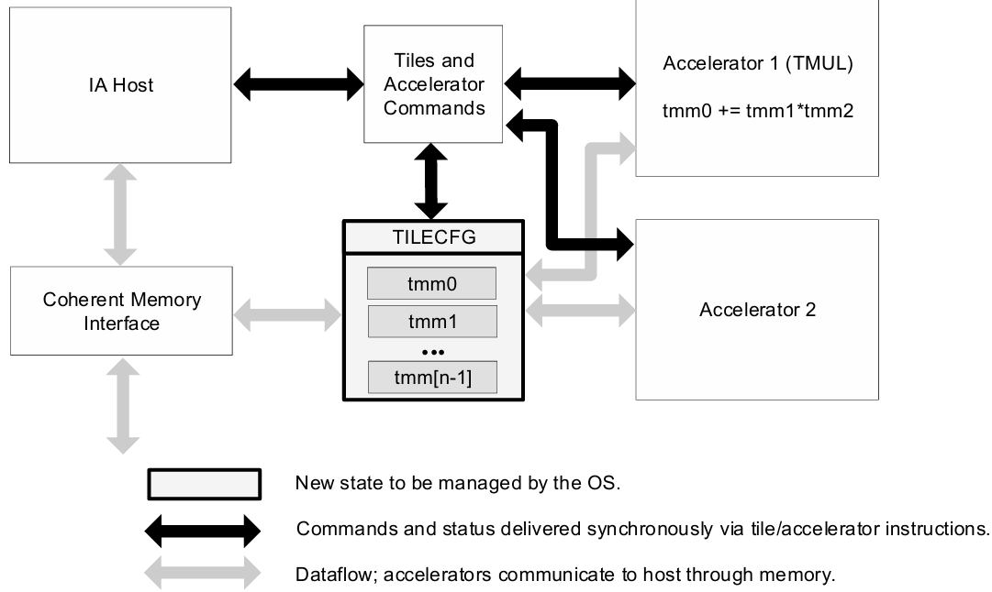
Intel’s Advanced Matrix Extensions (AMX)
Strategy: Enhance CPU with AI acceleration capabilities.
Architecture: An extension to the x86 ISA, not a separate chip.
Core Components:
  Tiles: 2D register files
  TMUL: dedicated matrix multiply instruction
  Explicit load/store/configuration model
  Instructions: tilecfg, tileload, tmul, tilestore
  Initial support: INT8, BF16 (extensions for FP16)

Slide 19
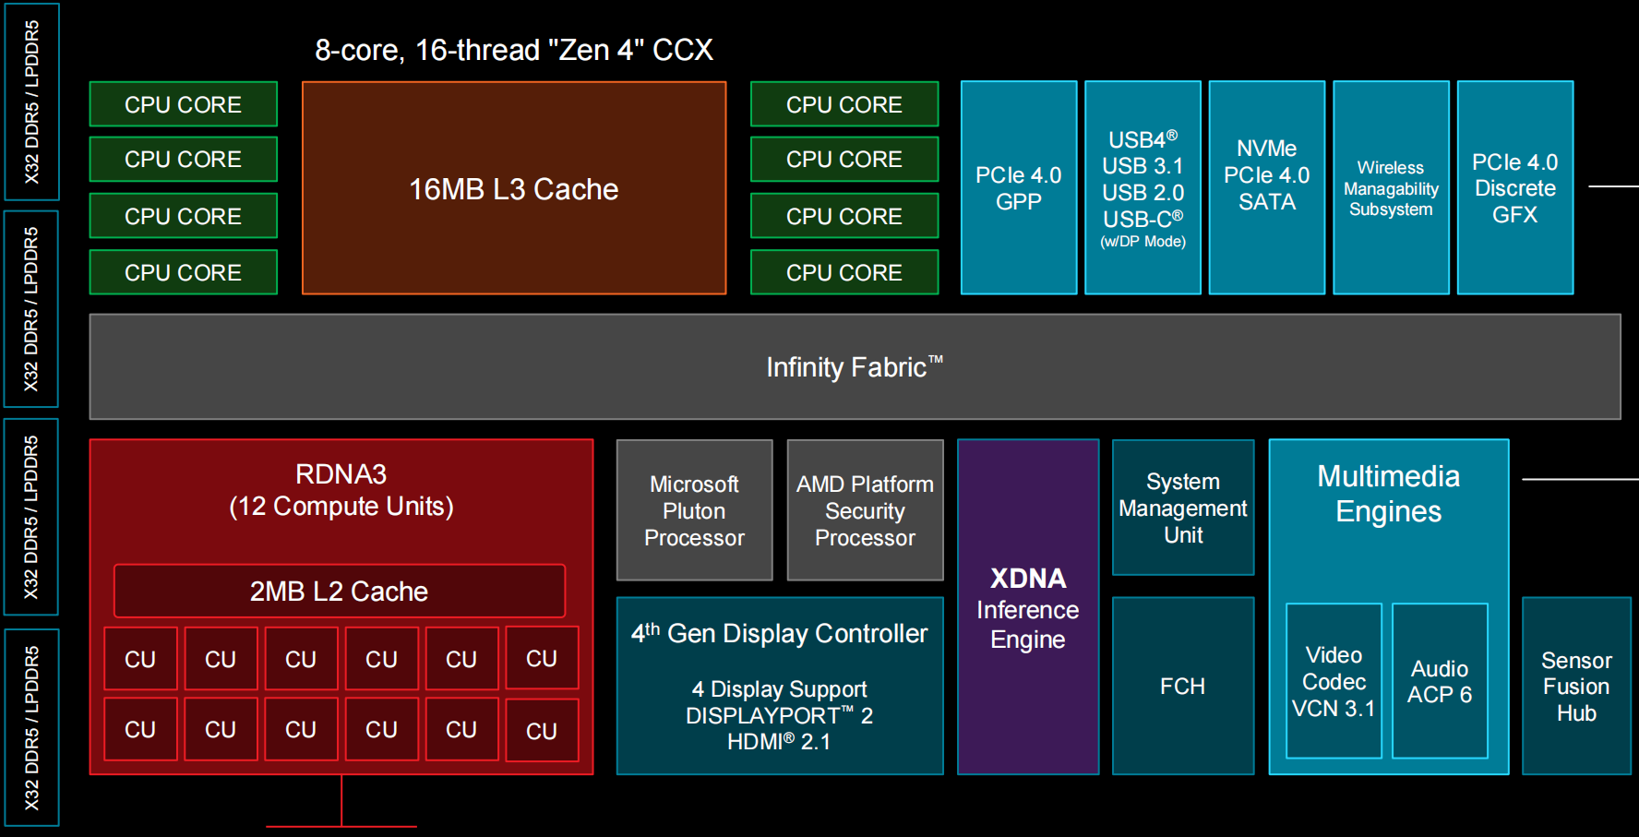
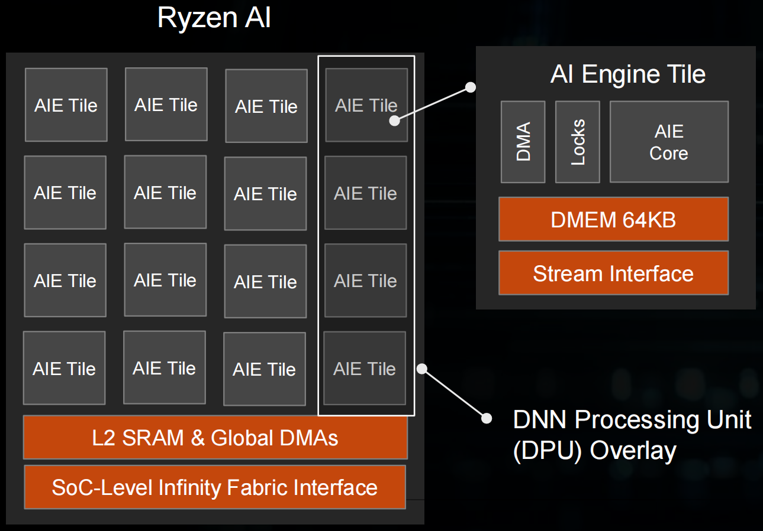
AMD Zen + RDNA + XDNA SoC
XDNA

Slide 20
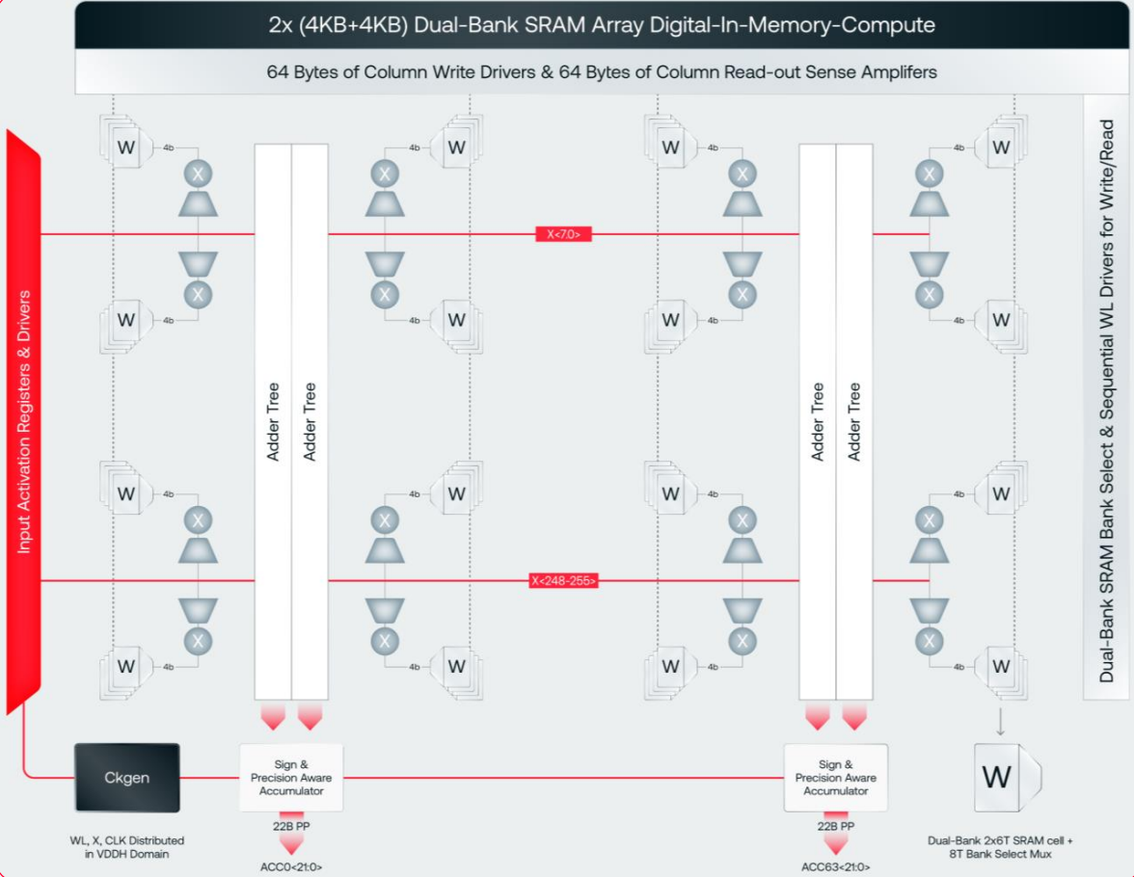

Digital IMC Architecture (d-Matrix)
Compute: Digital IMC (DIMC)
  Zero Data Movement: Logic units integrated within SRAM to eliminate transfer overhead.
  Digital Precision: Supports MXINT8/MXINT4 block-floating-point formats.
  Efficiency: 38 TOPS/W (vs. ~2.8 TOPS/W for H100).
Storage: SRAM & Memory Hierarchy
  Stash (Weights): 6MB/slice; 150 TB/s aggregate bandwidth.
  Global Memory (Activations): 4MB/slice.
  LPDDR5 (256GB): For massive models and KV Cache.
Scalability & Software
  Scale-Out: Transparent interconnect bypassing RDMA.
  Host-Free Runtime: RISC-V cores manage graph execution, eliminating Host CPU bottlenecks.

Slide 21
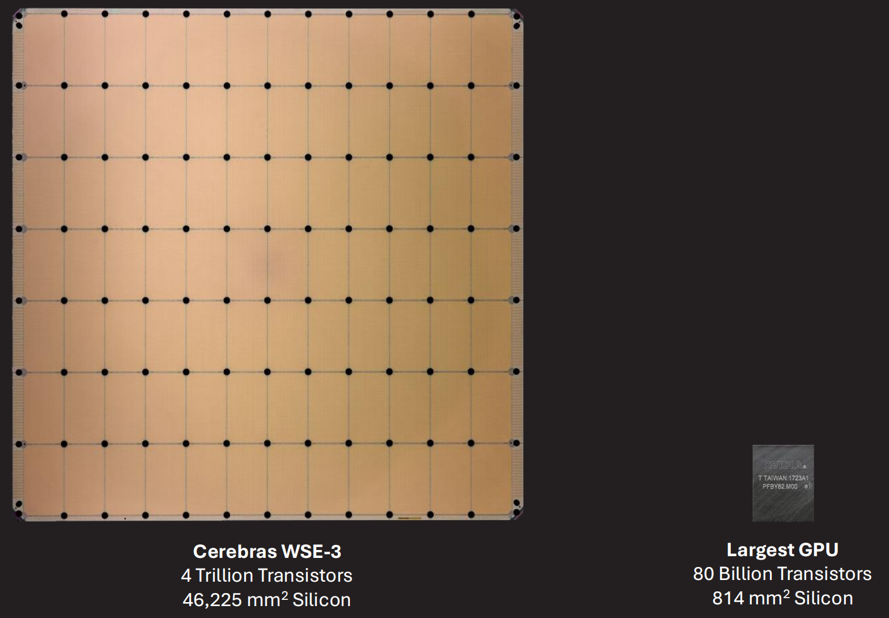

Wafer-Scale Architecture (Cerebras)
WSE-3 Specs (vs. NVIDIA H100)
  Die Area: 46,225 mm² (57x，↘)
  AI Cores: 900,000 AI cores (52x，↘)
  on-chip Memory: 44 GB SRAM (880x)
  Memory Bandwidth: 21 PB/s (7000x)
WSE-3 Core Architecture
  Co-located Compute & Memory: Logic and storage are tightly coupled to minimize latency.
  High-Performance AI Compute: 8/16-way SIMD supporting 16-bit/8-bit data formats.
  High-Bandwidth Storage: Massive local SRAM and specialized cache hierarchies.
Inference Strategy: On-Chip Pipeline Parallelism
  Physical Mapping: Model layers are mapped across different wafer regions.
  Near-Zero Latency: Communication happens via a high-speed Silicon Interconnect, effectively eliminating traditional networking overhead.

Slide 22


Supernode Architecture (NVL72 & CloudMatrix 384)
NVIDIA NVL72: "The Rack is the Chip"
  Chip-Centric, Compute-First Supernode: Designed as a unified computational entity.
  Architecture: 72 Blackwell GPUs integrated into a single rack, interconnected via a Copper Backplane (NVLink Switch).
  Objective: Emulate Wafer-Scale (WSI) performance using discrete components; leverages copper interconnects for rack-level All-to-All high bandwidth.
Huawei Cloud-Matrix 384
  System-Centric, Communication-First Unified Supernode: Prioritizes large-scale interconnect efficiency.
  Mechanism: Interconnects hundreds of Ascend processors via the proprietary HCCS protocol to build a Unified Memory Pool.
  General-Purpose Advantage: Unlike niche inference chips, it balances large-scale training and inference, backed by the mature CANN ecosystem.
[1] https://zhuanlan.zhihu.com/p/1919101924445254162

Slide 23
Model Parameter vs GPU Memory Capacity
NLP Moore’s Law
  Model Params: >10,000× growth in 7 years
GPU Memory Growth
  Memory Capacity: <10× growth in 7 years
Time | Model | Size
2018 | BERT-Large | 0.34 B
2019 | GPT-2 | 1.5 B
2020 | GPT-3 | 175 B
2023 | GPT-4 | ≈1.8 T (MoE)
2024 | Llama-3.1 | 405 B
2024 | Gemini 1.5 Pro | ≈1.5 T
2024 | DeepSeek-V3 | 671 B (MoE)
2025 | GPT-4.5 | ≈12.8 T (MoE)
Time | GPU | Memory Capacity | Memory Bandwidth
2018 | V100 | 32 GB | 900 GB/s
2020 | A100 | 80 GB | 2.0 TB/s
2022 | A800 | 80 GB | 2.0 TB/s
2023 | H100 | 94 GB | 3.9 TB/s
2024 | H200 | 141 GB | 4.8 TB/s
2025 | B200 | 192 GB | 8 TB/s
2025 | B300 | 288 GB | 10 TB/s
Massive-scale, high-bandwidth interconnects are mandatory
Notes:
AI model timeline: https://lifearchitect.ai/timeline/

Slide 24
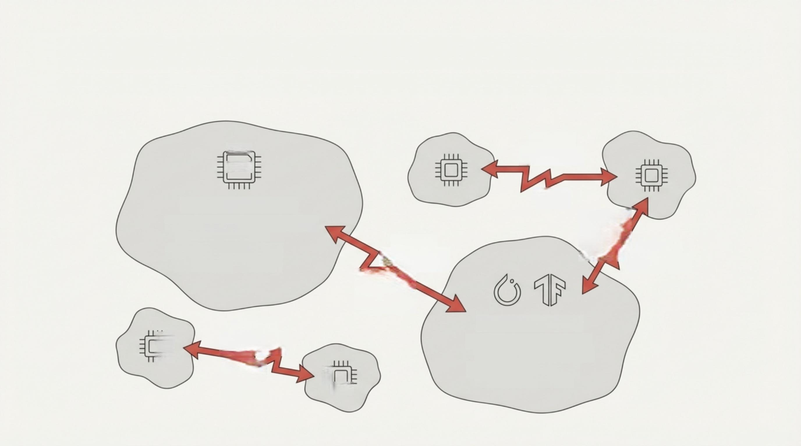
The AI Obstacle Course: The Challenge of a Multi-Chip World

Slide 25

The Solution: FlagOS, a Unified AI Software Stack

Slide 26
The Solution: FlagOS, a Unified AI Software Stack

Slide 27








https://space.bilibili.com/3546791834290849
https://github.com/flagos-ai
https://www.zhihu.com/people/95-22-20-18/posts
https://flagos.io/Home

Slide 28
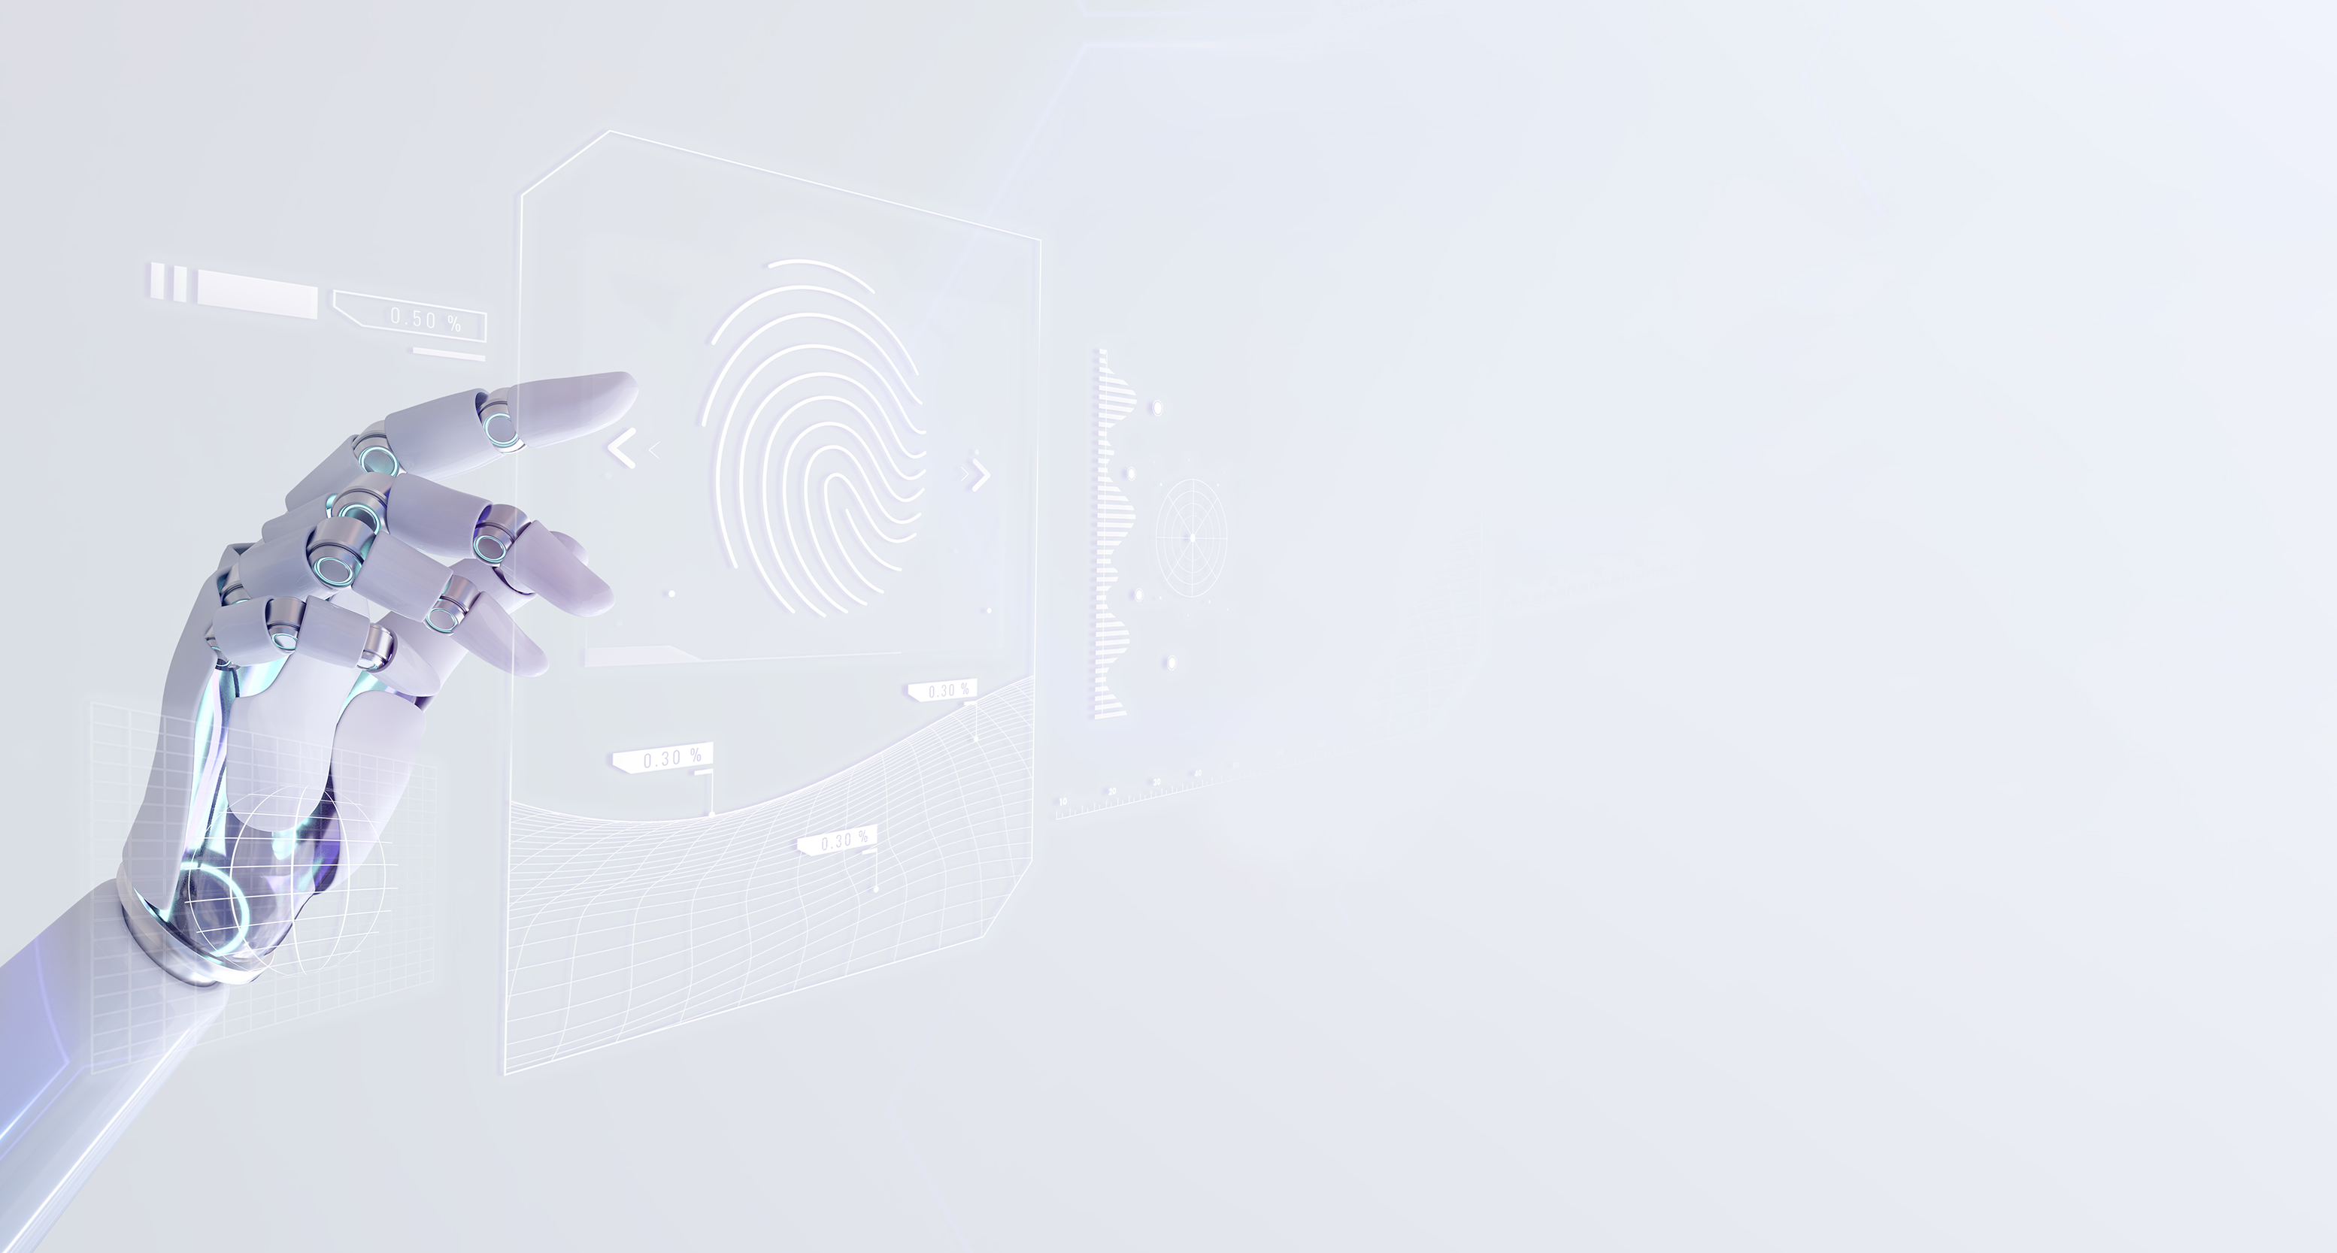
Thanks for your time！

